Slide 1
How to Get There? 怎么去？
Lesson 2: Explore

Slide 2
语法运用 句型2: …离…
Activity 4: Practice Grammar Pattern in Context (2)

Slide 3
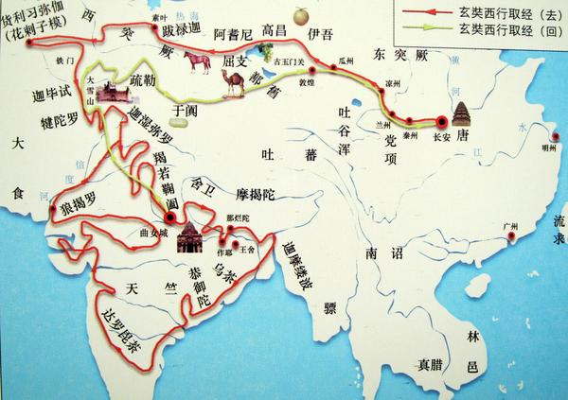
句型2: …离…
Place 1 + 离 + Place 2 + 有＃里(路)
Place 1 + 离 + Place 2 + Adv. + 近 / 远 Unless you're talking about a very specific distance, you'll normally want to pair 离 (lí) with the adjective 近 (jìn) for "close," or 远 (yuǎn) for "far."
Find the sentence structure in the text and identify Place 1 and Place 2 in the sentence.
孙Wùkōng：师父，我们离“西天”大学十万八千里，走路去太慢了，坐飞机又快又舒服。
所以，他们离“西天”大学远不远？

Slide 4
Place 1 + 离 + Place 2 + 有＃＃里(路) Place 1 + 离 + Place 2 + Adv. + 近 jìn / 远 yuǎn Unless you're talking about a very specific distance, you'll normally want to pair 离 (lí) with the adjective 近 (jìn) for "close," or 远 (yuǎn) for "far."
中国离美国有六千九百二十七英里路。
中国离美国很远。
6,927 Miles ／ 11,139 km

Slide 5
Place 1 + 离 + Place 2 + 有＃＃里(路) Place 1 + 离 + Place 2 + Adv. + 近 jìn / 远 yuǎn Unless you're talking about a very specific distance, you'll normally want to pair 离 (lí) with the adjective 近 (jìn) for "close," or 远 (yuǎn) for "far."
Worcester离Boston有47英里路。
我觉得Worcester离Boston很近。

Slide 6
Place 1 + 离 + Place 2+ 有＃＃里(路) Place 1 + 离 + Place 2 + Adv. + 近 jìn / 远 yuǎn Unless you're talking about a very specific distance, you'll normally want to pair 离 (lí) with the adjective 近 (jìn) for "close," or 远 (yuǎn) for "far."
0.9 Mile
https://s-media-cache-ak0.pinimg.com/736x/52/4b/01/524b01a48c443032a0aaeb277e31281b.jpg
https://s-media-cache-ak0.pinimg.com/736x/58/51/63/58516369ccc6a514ec9441d9b066b75c.jpg

Slide 7
Place 1 + 离 + Place 2 + 有＃＃里(路) Place 1 + 离 + Place 2 + Adv. + 近 jìn / 远 yuǎn Unless you're talking about a very specific distance, you'll normally want to pair 离 (lí) with the adjective 近 (jìn) for "close," or 远 (yuǎn) for "far."
0.2 Mile
https://lfcc.edu/wp-content/uploads/2014/08/130121_Student_Union_Header.jpg
https://d1gzo5vknddaf.cloudfront.net/uploads/post/featured_image/88/display_The_Learning_Curve_of_a_College_Classroom.jpg

Slide 8
Place 1 + 离 + Place 2 + 有＃＃里(路) Place 1 + 离 + Place 2 + Adv. + 近 jìn / 远 yuǎn Unless you're talking about a very specific distance, you'll normally want to pair 离 (lí) with the adjective 近 (jìn) for "close," or 远 (yuǎn) for "far."
北京
北京
上海
香港
2160 公里
1250 公里

